Slide 1
Miracles Among Gentiles!
Mark 7:24 – 8:10
Jesus Christ: A Closer Look!

Slide 2
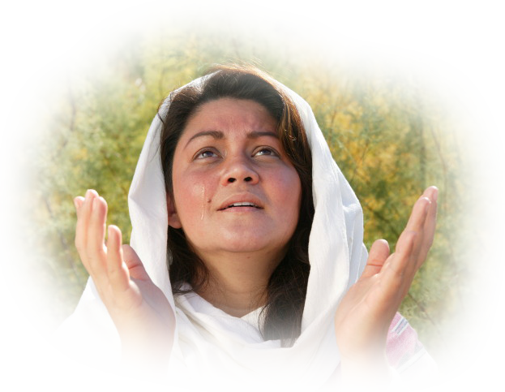
Miracles Among Gentiles!
The Forecast of a World for Christ!
Mark 7:24-30
“the woman was
a Gentile”
“Let the children be
satisfied first”
“children's crumbs”

Slide 3
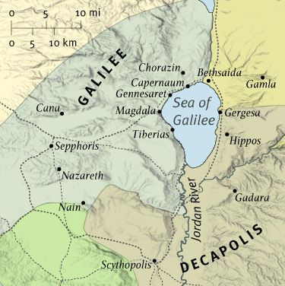
Miracles Among Gentiles!
Doing All Things Well!
Mark 7:31-37
“one who was deaf and spoke with difficulty”
“Be opened!”
“He has done
all things well”

Slide 4
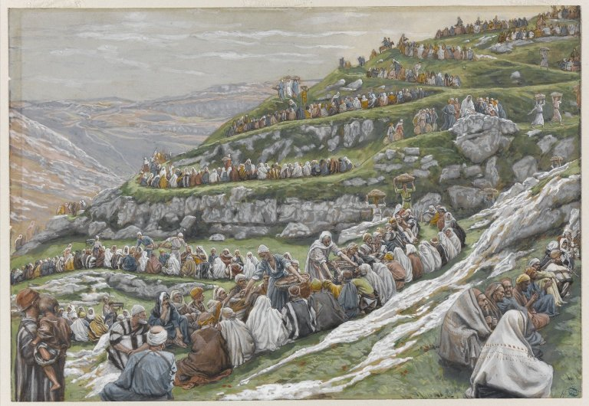
Miracles Among Gentiles!
Compassion Again!
Mark 8:1-10
“I feel compassion for
the people ”

Slide 5
Miracles Among Gentiles!
Mark 7:24 – 8:10
Jesus Christ: A Closer Look!

